Slide 1
Pleasure-purpose dataset
Summary of issues

Slide 2
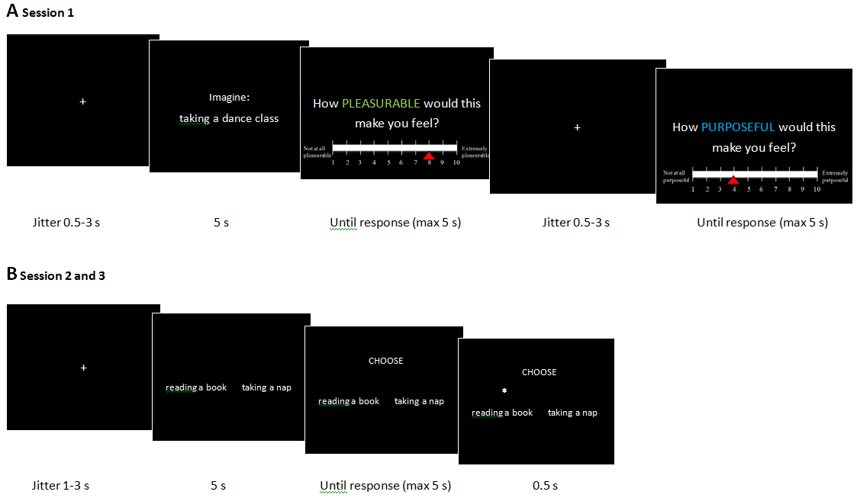
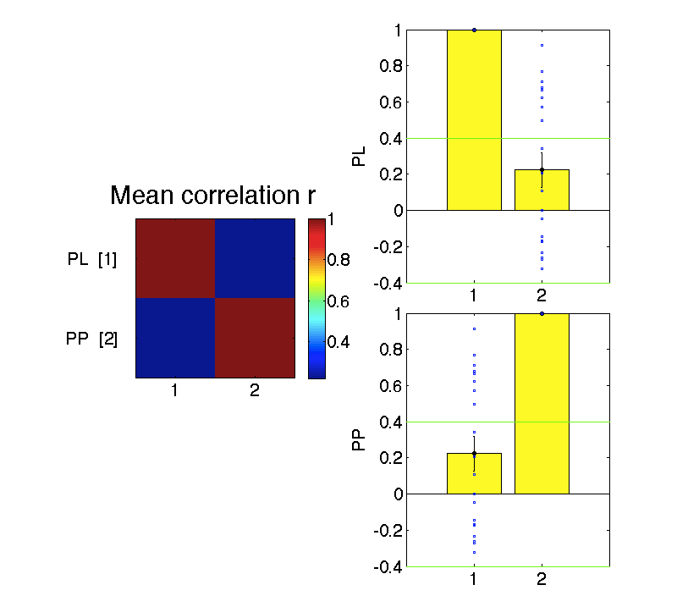
The correlation between PL & PP scores is an intrinsic problem for the analysis
Session 1 Ratings
The group-level mean of the correlation (within-subject) between PL & PP scores is relatively low
BUT, there is a huge range, with some subjects showing correlations >0.8
Only n=12 subjects show a correlation r<0.4 (arbitrary threshold)
The square and bar plots here all show the correlation between PL and PP scores. Orange dotted arrows indicate which square-plots correspond to which bar/scatter-plot
Top Square plot shows mean r statistic
Right Yellow bar plots show the same r statistic, but also shows the range across the sample of subjects (n=20; each blue dot is a single subject). Position of yellow bars mirrors square plot (i.e. 2x2) – y axis label indicates the regressor being correlated in that row. X-axis labels indicate variable no. being correlated

Slide 3
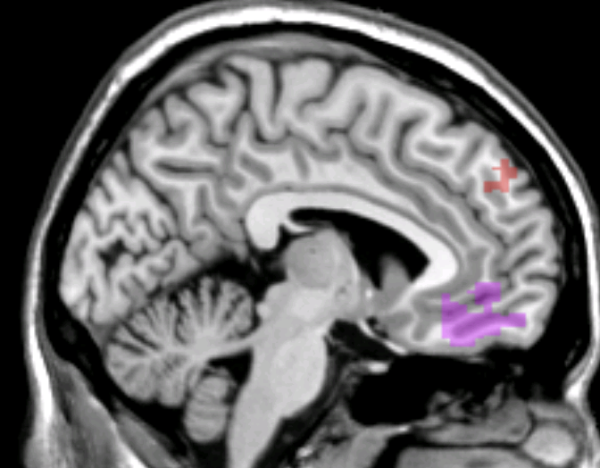
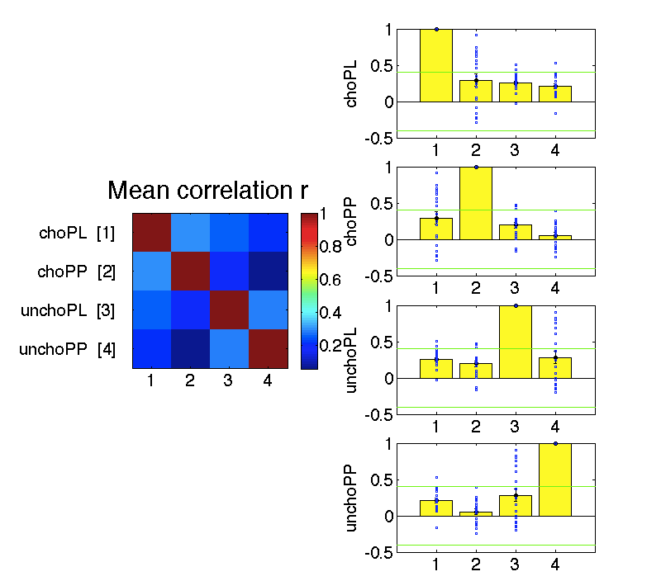
The correlation may be surmountable in the rating session, but it’s unlikely that one could untangle PL and PP in the choice stage
Positive tracking of PL & PP scores in the vmPFC (n=12)
Rating
Choice
In the relatively PL-PP-decorrelated sample (n=12), we do already see sensible WB-FWE activation (e.g. in vmPFC, parietal cortex) during the rating stage
But, because events are co-presented in the choice stage, we’re unlikely to ever be able to pull PL & PP apart. Unlikely to be able to use rating session activity to predict choice session behaviour.
Dataset could however still be used to look at neural activity during rating – e.g. imagination, attentional switching between dimensions, etc

